Slide 1
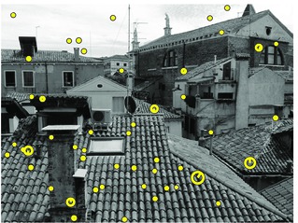
Matlab Tutorial. Session 2. SIFT
Gonzalo Vaca-Castano

Slide 2
Sift purpose
Find and describe interest points invariants to:
Scale
Rotation
Illumination
Viewpoint

Slide 3
Do it Yourself
Constructing a scale space
LoG Approximation
Finding keypoints
Get rid of bad key points (A technique similar to the Harris Corner Detector)
Assigning an orientation to the keypoints
Generate SIFT features
*http://www.aishack.in/2010/05/sift-scale-invariant-feature-transform/2/

Slide 4
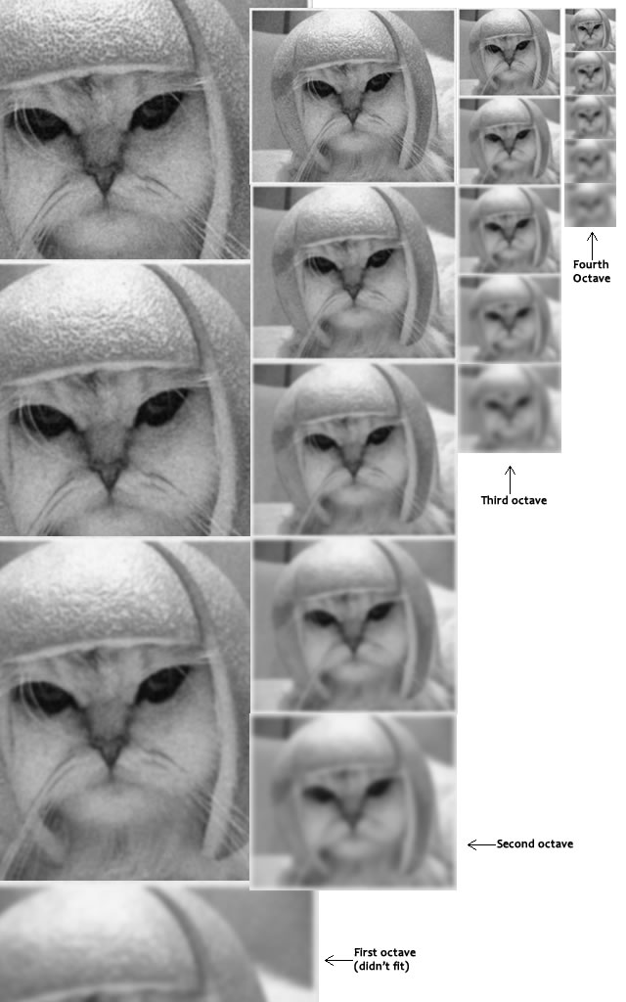
Construction of a scale space
SIFT takes scale spaces to the next level. You take the original image, and generate progressively blurred out images. Then, you resize the original image to half size. And you generate blurred out images again. And you keep repeating.
The creator of SIFT suggests that 4 octaves and 5 blur levels are ideal for the algorithm

Slide 5

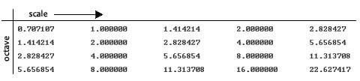
Construction of a scale space (details)
The first octave
If the original image is doubled in size and antialiased a bit (by blurring it) then the algorithm produces more four times more keypoints. The more the keypoints, the better!
Blurring
Amount of Blurring

Slide 6
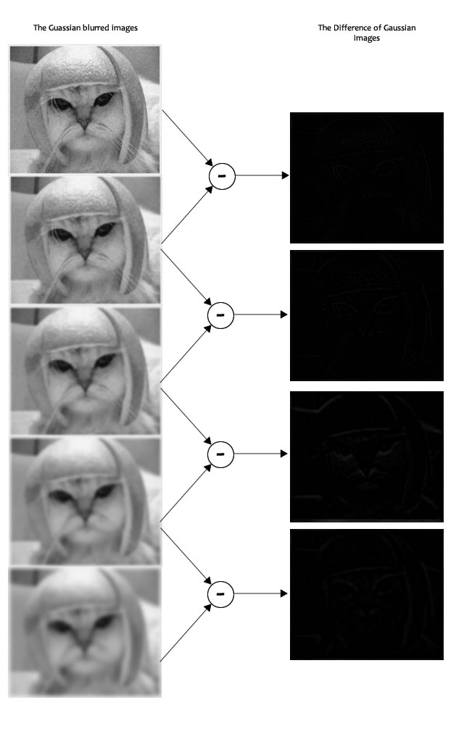
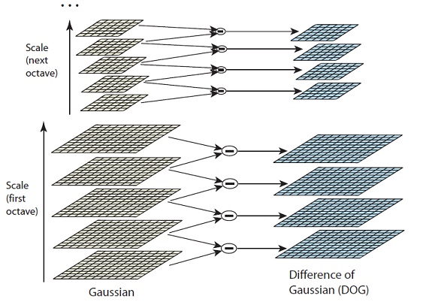
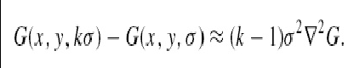
LoG approximation

Slide 7
Matlab Implementation !
% %%% Create first interval of the first octave %%%%%
init_image=impyramid(gauss_filter(image1,antialiassigma,4*antialiassigma),'expand');
gaussians(1)={gauss_filter(init_image,sigmavalue,4*sigmavalue)};
% %%% Generates all the blurred out images for each octave %%%%
% %%% and the DoG images %%%%
for i=1:num_octaves
sigma=sigmavalue; %reset the sigma value
for j=1:(num_intervals+2)
sigma=sigma*2^((j-1)/2); %Assign a sigma value acording to the scale
previmage=cell2mat(gaussians(j,i)); %Obtain the previous image
newimage=gauss_filter(previmage,sigma,4*sigma); %apply a new smoothing
dog=previmage-newimage; %calculate the difference of gaussians
%save the results
gaussians(j+1,i)={newimage};
dogs(j,i)={dog};
end
%Build the init image in the next level
if(i<num_octaves)
lowscale=cell2mat(gaussians(num_intervals+1,i));
upscale=impyramid(lowscale,'reduce');
gaussians(1,i+1)={upscale};
end
end

Slide 8
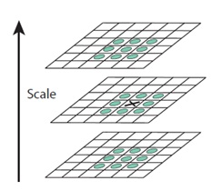
Finding keypoints
a) Locate maxima/minima in DoG images

Slide 9
Matlab Implementation
for i=1:num_octaves
for j=2:(num_intervals+1)
% Obtain the matrices where to look for the extrema
level=cell2mat(dogs(j,i));
up=cell2mat(dogs(j+1,i));
down=cell2mat(dogs(j-1,i));
[sx,sy]=size(level);
%look for a local maxima
local_maxima=(level(2:sx-1,2:sy-1)>level(1:sx-2,1:sy-2)) & ( level(2:sx-1,2:sy-1) > level(1:sx-2,2:sy-1) ) & (level(2:sx-1,2:sy-1)>level(1:sx-2,3:sy)) & (level(2:sx-1,2:sy-1)>level(2:sx-1,1:sy-2)) & (level(2:sx-1,2:sy-1)>level(2:sx-1,3:sy)) & (level(2:sx-1,2:sy-1)>level(3:sx,1:sy-2)) & (level(2:sx-1,2:sy-1)>level(3:sx,2:sy-1)) & (level(2:sx-1,2:sy-1)>level(3:sx,3:sy)) ;
local_maxima=local_maxima & (level(2:sx-1,2:sy-1)>up(1:sx-2,1:sy-2)) & ( level(2:sx-1,2:sy-1) > up(1:sx-2,2:sy-1) ) & (level(2:sx-1,2:sy-1)>up(1:sx-2,3:sy)) & (level(2:sx-1,2:sy-1)>up(2:sx-1,1:sy-2)) & (level(2:sx-1,2:sy-1)>up(2:sx-1,2:sy-1)) & (level(2:sx-1,2:sy-1)>up(2:sx-1,3:sy)) & (level(2:sx-1,2:sy-1)>up(3:sx,1:sy-2)) & (level(2:sx-1,2:sy-1)>up(3:sx,2:sy-1)) & (level(2:sx-1,2:sy-1)>up(3:sx,3:sy)) ;
local_maxima=local_maxima & (level(2:sx-1,2:sy-1)>down(1:sx-2,1:sy-2)) & ( level(2:sx-1,2:sy-1) > down(1:sx-2,2:sy-1) ) & (level(2:sx-1,2:sy-1)>down(1:sx-2,3:sy)) & (level(2:sx-1,2:sy-1)>down(2:sx-1,1:sy-2)) & (level(2:sx-1,2:sy-1)>down(2:sx-1,2:sy-1)) & (level(2:sx-1,2:sy-1)>down(2:sx-1,3:sy)) & (level(2:sx-1,2:sy-1)>down(3:sx,1:sy-2)) & (level(2:sx-1,2:sy-1)>down(3:sx,2:sy-1)) & (level(2:sx-1,2:sy-1)>down(3:sx,3:sy)) ;
%look for a local minima
local_minima=(level(2:sx-1,2:sy-1)>level(1:sx-2,1:sy-2)) & ( level(2:sx-1,2:sy-1) > level(1:sx-2,2:sy-1) ) & (level(2:sx-1,2:sy-1)>level(1:sx-2,3:sy)) & (level(2:sx-1,2:sy-1)>level(2:sx-1,1:sy-2)) & (level(2:sx-1,2:sy-1)>level(2:sx-1,3:sy)) & (level(2:sx-1,2:sy-1)>level(3:sx,1:sy-2)) & (level(2:sx-1,2:sy-1)>level(3:sx,2:sy-1)) & (level(2:sx-1,2:sy-1)>level(3:sx,3:sy)) ;
local_minima=local_minima & (level(2:sx-1,2:sy-1)>up(1:sx-2,1:sy-2)) & ( level(2:sx-1,2:sy-1) > up(1:sx-2,2:sy-1) ) & (level(2:sx-1,2:sy-1)>up(1:sx-2,3:sy)) & (level(2:sx-1,2:sy-1)>up(2:sx-1,1:sy-2)) & (level(2:sx-1,2:sy-1)>up(2:sx-1,2:sy-1)) & (level(2:sx-1,2:sy-1)>up(2:sx-1,3:sy)) & (level(2:sx-1,2:sy-1)>up(3:sx,1:sy-2)) & (level(2:sx-1,2:sy-1)>up(3:sx,2:sy-1)) & (level(2:sx-1,2:sy-1)>up(3:sx,3:sy)) ;
local_minima=local_minima & (level(2:sx-1,2:sy-1)>down(1:sx-2,1:sy-2)) & ( level(2:sx-1,2:sy-1) > down(1:sx-2,2:sy-1) ) & (level(2:sx-1,2:sy-1)>down(1:sx-2,3:sy)) & (level(2:sx-1,2:sy-1)>down(2:sx-1,1:sy-2)) & (level(2:sx-1,2:sy-1)>down(2:sx-1,2:sy-1)) & (level(2:sx-1,2:sy-1)>down(2:sx-1,3:sy)) & (level(2:sx-1,2:sy-1)>down(3:sx,1:sy-2)) & (level(2:sx-1,2:sy-1)>down(3:sx,2:sy-1)) & (level(2:sx-1,2:sy-1)>down(3:sx,3:sy)) ;
extrema=local_maxima | local_minima;
end
end

Slide 10
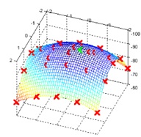

Finding keypoints
b) Find subpixel maxima/minima

Slide 11
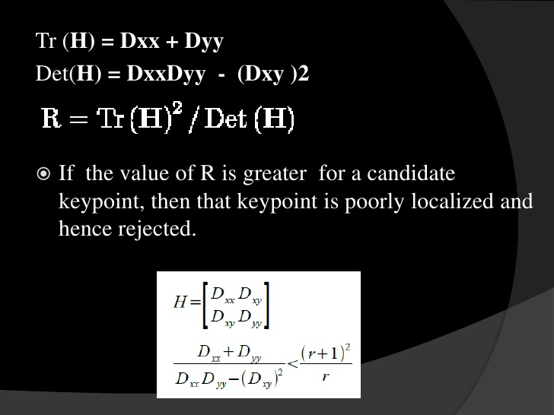
Get rid of bad key points
Removing low contrast features
If the magnitude of the intensity (i.e., without sign) at the current pixel in the DoG image (that is being checked for minima/maxima) is less than a certain value, it is rejected
Removing edges

Slide 12
Matlab Implementation
%indices of the extrema points
[x,y]=find(extrema);
numtimes=size(find(extrema));
for k=1:numtimes
x1=x(k);
y1=y(k);
if(abs(level(x1+1,y1+1))<contrast_threshold) %low contrast point are discarded
extrema(x1,y1)=0;
else %keep being extrema, check for edge
rx=x1+1;
ry=y1+1;
fxx= level(rx-1,ry)+level(rx+1,ry)-2*level(rx,ry); % double derivate in x direction
fyy= level(rx,ry-1)+level(rx,ry+1)-2*level(rx,ry); % double derivate in y direction
fxy= level(rx-1,ry-1)+level(rx+1,ry+1)-level(rx-1,ry+1)-level(rx+1,ry-1); %derivate inx and y direction
trace=fxx+fyy;
deter=fxx*fyy-fxy*fxy;
curvature=trace*trace/deter;
curv_threshold= ((r_curvature+1)^2)/r_curvature;
if(deter<0 || curvature>curv_threshold) %Reject edge points
extrema(x1,y1)=0;
end
end
end

Slide 13
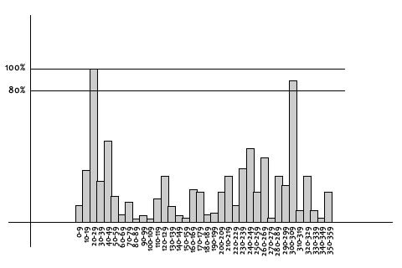
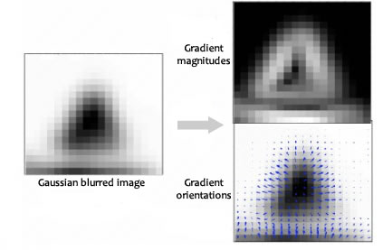
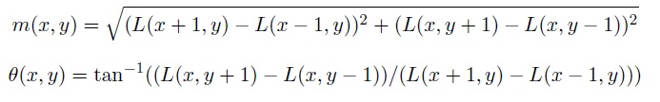
Assigning an orientation to the keypoints

Slide 14
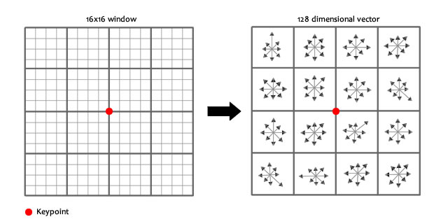
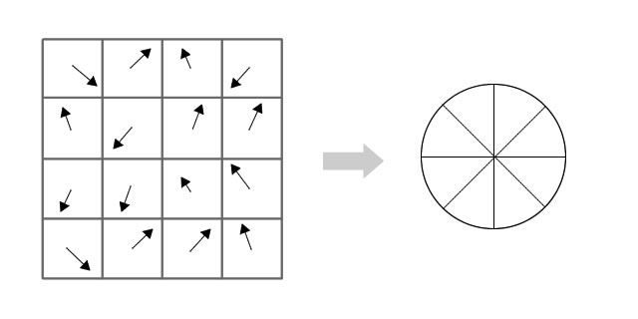
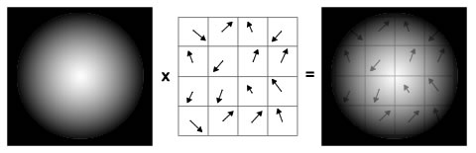
Generate SIFT features

Slide 15
Generate SIFT features
You take a 16×16 window of “in-between” pixels around the keypoint. You split that window into sixteen 4×4 windows. From each 4×4 window you generate a histogram of 8 bins. Each bin corresponding to 0-44 degrees, 45-89 degrees, etc. Gradient orientations from the 4×4 are put into these bins. This is done for all 4×4 blocks. Finally, you normalize the 128 values you get.
To solve a few problems, you subtract the keypoint’s orientation and also threshold the value of each element of the feature vector to 0.2 (and normalize again).

Slide 16
Testing the detector
i=imread('groceries_gray.jpg');
sift(i,3,5,1.1)

Slide 17
Vl_feat
The VLFeat open source library implements popular computer vision algorithms including SIFT, MSER, k-means, hierarchical k-means, agglomerative information bottleneck, and quick shift. It is written in C for efficiency and compatibility, with interfaces in MATLAB for ease of use, and detailed documentation throughout. It supports Windows, Mac OS X, and Linux

Slide 18
Vl_feat
Download vl_feat from http://www.vlfeat.org/
run('VLFEATROOT/toolbox/vl_setup')
Permanent setup
To permanently add VLFeat to your MATLAB environment, add this line to your startup.m file:
run('VLFEATROOT/toolbox/vl_setup')

Slide 19
Extracting frames and descriptors
pfx = fullfile(vl_root,'data','a.jpg') ;
I = imread(pfx) ;
image(I) ;
I = single(rgb2gray(I)) ;
[f,d] = vl_sift(I) ;
perm = randperm(size(f,2)) ;
sel = perm(1:50) ;
h1 = vl_plotframe(f(:,sel)) ;
h2 = vl_plotframe(f(:,sel)) ;
set(h1,'color','k','linewidth',3) ;
set(h2,'color','y','linewidth',2) ;
h3 = vl_plotsiftdescriptor(d(:,sel),f(:,sel)) ;
set(h3,'color','g')

Slide 20
Basic Matching
[fa, da] = vl_sift(Ia) ;
[fb, db] = vl_sift(Ib) ;
[matches, scores] = vl_ubcmatch(da, db) ;

Slide 21
Visualization
m1= fa (1:2,matches(1,:));
m2=fb(1:2,matches(2,:));
m2(1,:)= m2(1,:)+640*ones(1,size(m2,2));
X=[m1(1,:);m2(1,:)];
Y=[m1(2,:);m2(2,:)];
imshow(c);
hold on;
line(X,Y)
vl_plotframe(aframe(:,matches(1,:)));
vl_plotframe(m2);

Slide 22
Custom frames
The MATLAB command vl_sift (and the command line utility) can bypass the detector and compute the descriptor on custom frames using the Frames option.
For instance, we can compute the descriptor of a SIFT frame centered at position (100,100), of scale 10 and orientation -pi/8 by
fc = [100;100;10;-pi/8] ;
[f,d] = vl_sift(I,'frames',fc) ;
fc = [100;100;10;0] ;
[f,d] = vl_sift(I,'frames',fc,'orientations') ;

